Slide 1
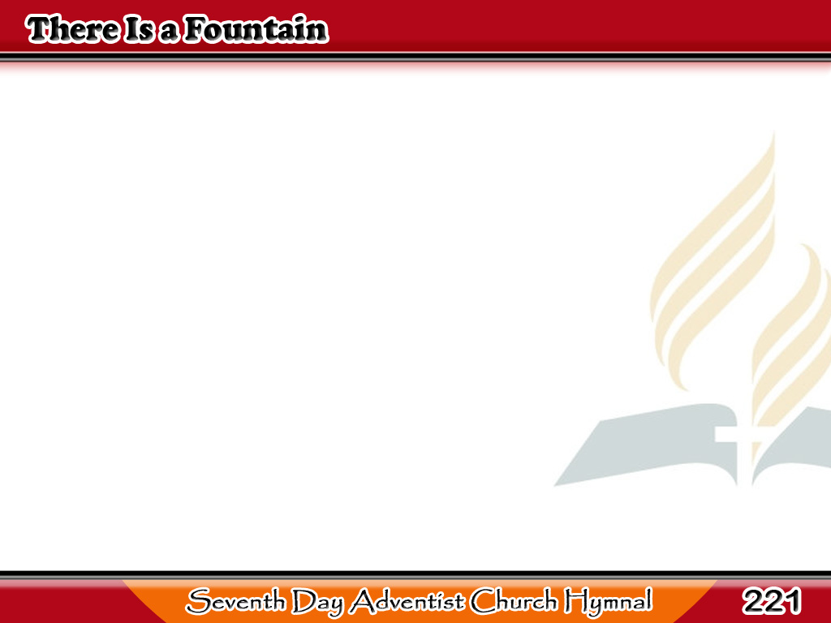
May Bukal ng Dugong Buhay
There is a fountain
filled with blood,
Drawn from Immanuel’s veins;
1/6

Slide 2
May Bukal ng Dugong Buhay
And sinners plunged
beneath that flood,
Lose all their guilty stains,
1/6

Slide 3
May Bukal ng Dugong Buhay
Lose all their guilty stains,
Lose all their guilty stains;
And sinners plunged
beneath that flood,
Lose all their guilty stains.
1/6

Slide 4
May Bukal ng Dugong Buhay
The dying thief rejoiced to see
That fountain in his day;
And there may I,
though vile as he,
Wash all my sins away,
2/6

Slide 5
May Bukal ng Dugong Buhay
Wash all my sins away,
Wash all my sins away;
And there may I,
though vile as he,
Wash all my sins away.
2/6

Slide 6
May Bukal ng Dugong Buhay
Thou dying Lamb!
Thy precious blood
Shall never lose its power,
3/6

Slide 7
May Bukal ng Dugong Buhay
Till all the ransomed
church of God
Are saved, to sin no more,
3/6

Slide 8
May Bukal ng Dugong Buhay
Are saved, to sin no more,
Are saved, to sin no more;
Till all the ransomed
church of God
Are saved, to sin no more.
3/6

Slide 9
May Bukal ng Dugong Buhay
E’er since by faith
I saw the stream
Thy flowing wounds supply,
4/6

Slide 10
May Bukal ng Dugong Buhay
Redeeming love
has been my theme,
And shall be till I die,
4/6

Slide 11
May Bukal ng Dugong Buhay
And shall be till I die,
And shall be till I die;
Redeeming love
has been my theme,
And shall be till I die.
4/6

Slide 12
May Bukal ng Dugong Buhay
Lord, I believe
Thou hast prepared,
Unworthy though I be,
5/6

Slide 13
May Bukal ng Dugong Buhay
For me a bloodbought,
free reward,
A golden harp for me!
5/6

Slide 14
May Bukal ng Dugong Buhay
A golden harp for me!
A golden harp for me!
For me a bloodbought,
free reward,
A golden harp for me!
5/6

Slide 15
May Bukal ng Dugong Buhay
There in a nobler, sweeter song,
I’ll sing Thy power to save,
When this poor lisping,
stammering tongue
Is ransomed from the grave,
6/6

Slide 16
May Bukal ng Dugong Buhay
Is ransomed from the grave,
Is ransomed from the grave;
When this poor lisping,
stammering tongue
Is ransomed from the grave.
6/6

